Slide 1
DIGITAL PORTFOLIO
STUDENTS NAME:ANBU SELVAN
REGISTRATION NO:2422K2152
NMID:CE2212D546FB93ABC01408737717
COLLEGE: Govt college of arts and science Gudalur
UNIVERSITY: Bharathiyar university

Slide 2
DIGITAL PORTFOLIO
A digital portfolio which tells about the idea's and also to showcase the skill and knowledge of him .here I have created a basic portfolio in addition I induced my idea of addiction breaker on portfolio project session

Slide 3
Agenda:
Problem statement
Project overview
End users
Tools and technologies
Portfolio design and layout
Features and functionality
Results and screenshots
Conclusion
Gothub links

Slide 4
PROBLEM STATEMENT
Today many of the companies look for skilled employees and due to regular resume the company needs to move a step ahead to find if the person has the ability but due to digital portfolio they already have an assurance of their work

Slide 5
PROJECT OVERVIEW
the project has two faces one it contains a digital portfolio for IT sector which showcase my skills and abilities and nextly I have added a addiction breake idea to it
My portfolio contains the projects (learning system) and my skills on html,java ,java script and css
I have a degree of b.sc computer science which I had gained ideas of programming languages and architecture of system in addition I have some problem solving skills

Slide 6
End users
Students: who can take a reference for the template and use it for their academic project or for resumes
Recruiters: where the selection process becomes a bit liberal by the candidates work preview
Professional: who can show case their work to get attention from their requirements group

Slide 7
Tools and technologies
CSS(cascading stylesheet)
Make the webpage a bit appealing and covers the structure of html and also adds some elegance
JAVA SCRIPT
This helps me in making the interaction as well as the redirection of the portfolio
TOOLS
the tools used here is the code pen that enables to write and view the output
HTML(hyper text transfer protocol)
which helps in defining the basic structure for portfolio and learning system

Slide 8
Design and layout
•It has a header session that has a simple overview of skill set
Home has a simple navigaton and it has some simple statements regarding myself
•The skill session has the tools that I'm coded off
The contact session has the submit type in learning system it has my contact
•I created it in a responsive layout using flex
Which could adapt as per screen size

Slide 9
Features and functionality
It is designed with flex layout and animation on zoom in
The project is showcased and a redirecting link in placed with button
It has a column of contacts
It is designed to respond differently as per the device and screen size

Slide 10
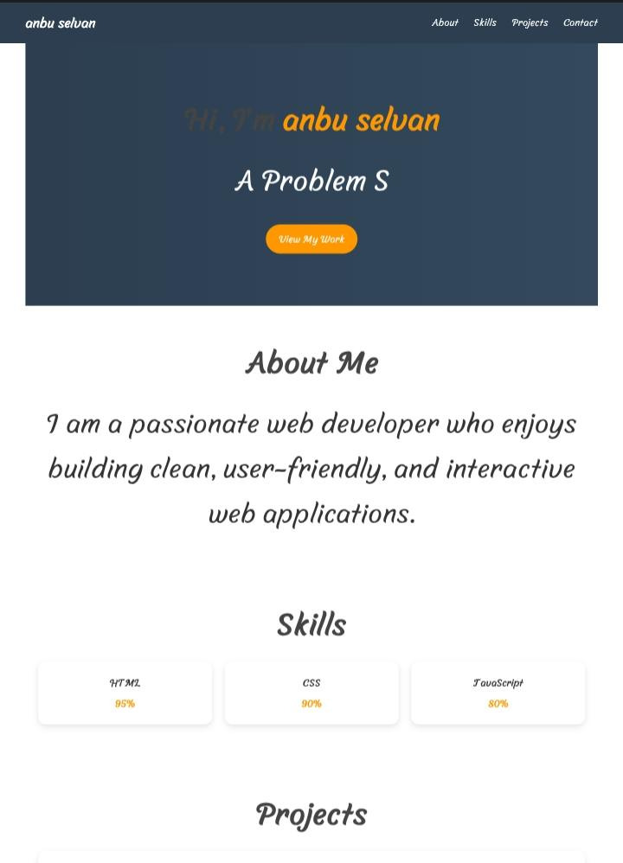
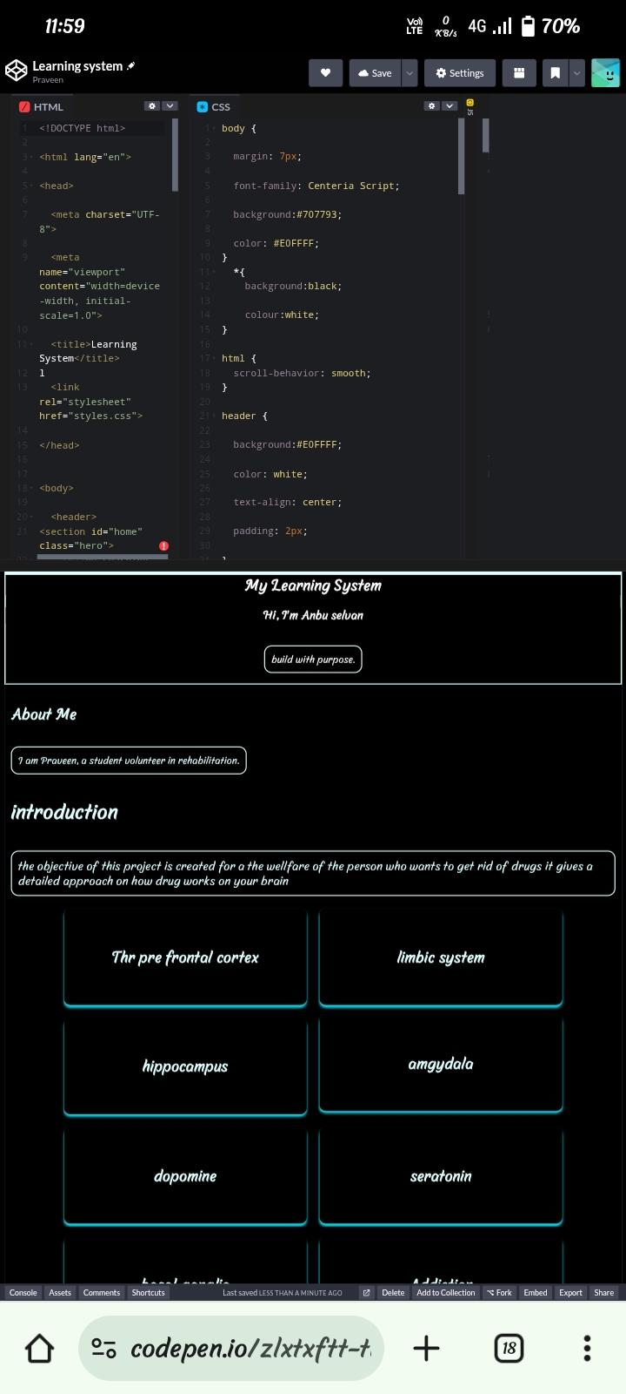
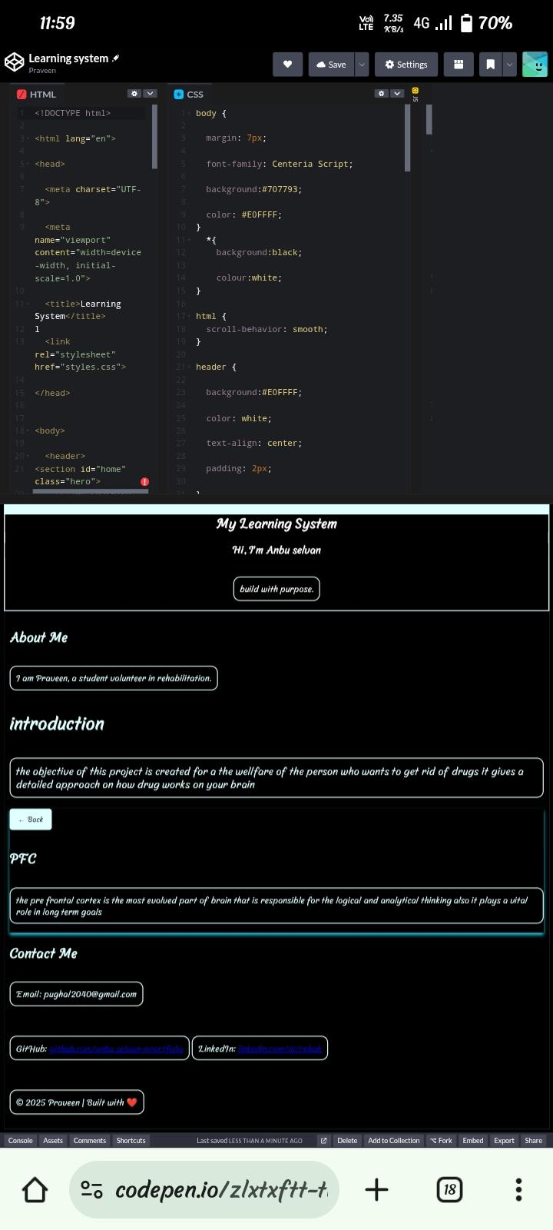
Results and screenshots

Slide 11
Conclusion
The project highlights the use of free resources to learn and create as per our well-being
In addition the learning system project if developed could help the society which has the awareness of drugs effects and ways to get rid of
The portfolio would benefit recruiting companies and the job seekers
Github link:https://codepen.io/zlxtxftt-the-looper/pen/pvjxbya

